Slide 1
Cinematic Shot Generation using Convex Optimization
By Haran Raajesh
202101005, CSE, haran.raajesh@students.iiit.ac.in

Slide 2
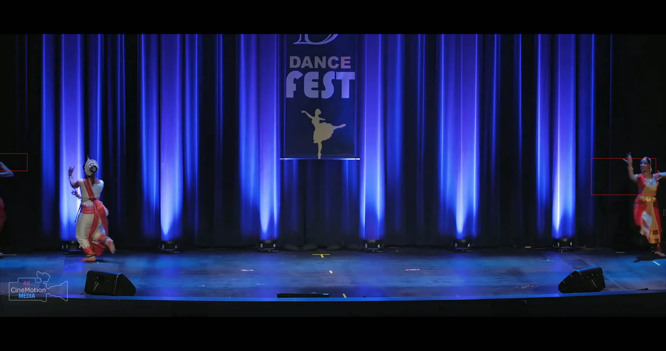
Overview of the problem

Slide 3


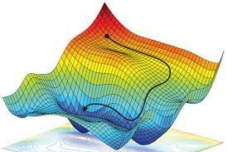
CONVEX Optimization
Minimize a function f₀(x)
Subject to a set of constraints:
f_{i}(x) < 0, i = 1… m
Ax = b

Slide 4
Our goal is to frame the SHAKY BOUNDING BOX PROBLEM AS AN OPTIMIZATION PROBLEM…

Slide 5
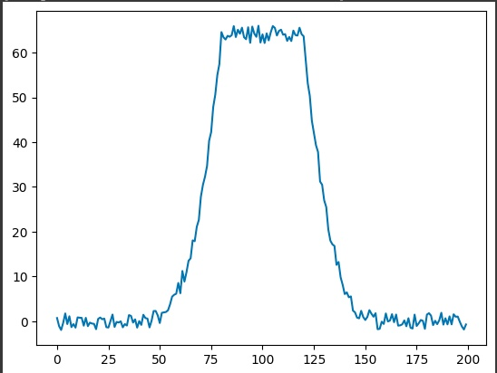
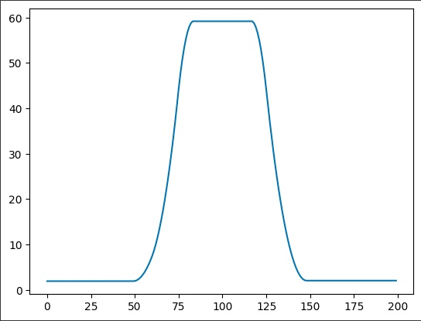
A SIMPLER EXAMPLE

Slide 6

A SIMPLER Example CONT…
We think of this problem as trying to minimize the following function:
f(r) = ½ $Σ$ ( r – x)² + a regularization term that penalizes high differences between consecutive elements in the r vector
A suitable regularization term was found to be the summation of a linear combination of the first order L1 and the third order L1 norms of consecutive elements of the r vector

Slide 7
BACK TO the Bounding BOX PROBELM
The bounding box for a dancer in each frame, is defined by the coordinates of center and its height.
So we can consider the x coordinate of the center, y coordinate of the center, and the height of the bounding boxes in all the frames of the video to be the noisy signal that we have to smoothen out

Slide 8
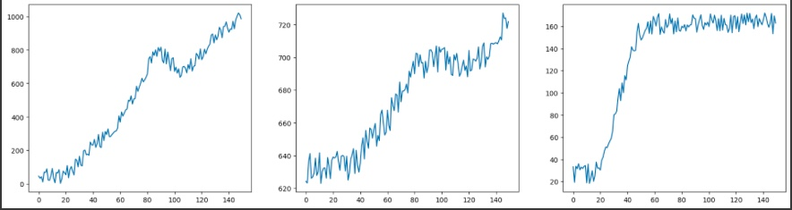
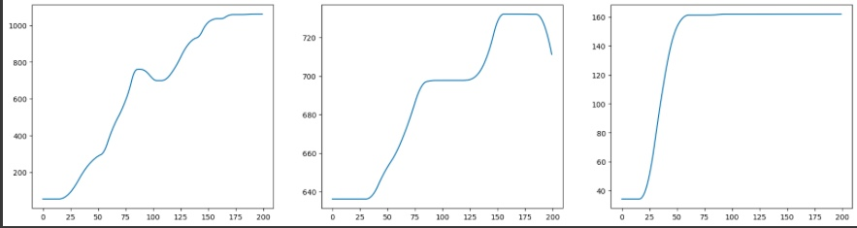
Connecting the problem to our example
X_{c} Y_{c} Height

Slide 9

FINAL OUTPUT

